Slide 1
RABET-V Pilot Program
April Update
Aaron Wilson, Sr. Director of Election Security

Slide 2
RABET-V Goal
Produce a flexible, rapid, and cost-efficient process for verifying non-voting election systems for
Initial product version
Subsequent product revisions
Non-Voting Election Technology
Electronic Pollbooks
Election Night Reporting
Electronic Ballot Delivery
Other internet-connected election administration technology

Slide 3
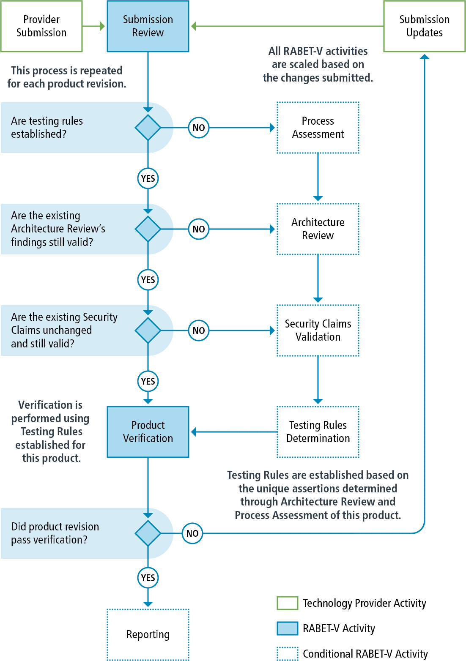
RABET-V Process Flow
RABET-V is a total of eight activities
Initial Submission – all activities
Product Revision Submission – varies
The Process Assessment, Architecture Review, and Security Claims Validation activities provide assertions about the system’s construction which inform the Testing Rules Determination
Product Verification verifies security claims and basic product functionality
Notes:
So how is this done? Change to next slide

Slide 4
RABET-V Provides Incentives for…
Providers to
have high-quality, modern system architectures that are more resistant to attacks and more resilient in recovery
have robust, risk-mitigating software development processes
update in smaller, more manageable cycles, more accurately reflecting the modern age of software development
Election authorities to
draw consistent centralized information, resulting in quicker decisions and reduced, amortized overall cost.
Notes:
Well architected, modern technology systems should safely permit security patching with low performance impact

Slide 5
RABET-V Pilot Program
Steering Committee – Chaired by Aaron Wilson, CIS
Includes Federal agencies, states election officials, vendors
Technical Advisory Committee – subject matter experts from various fields
Participants:
Scytl – Election Night Reporting
VR Systems – Electronic Pollbook, Election Night Reporting
KNOWiNK – Electronic Pollbook
Voting Works – RLA Software
Program Administration – Jared, John, Katy, Phil (The Turnout)
Research Lead – Dr. Mike Garcia (CIS)
https://github.com/it-dept-cis/RABET-V-Pilot

Slide 6
Committees
Steering Committee
Technical Advisory Committee
CIS – Aaron Wilson
EAC – Don Palmer & Jerome Lovato
FVAP – David Beirne
Ohio Elections – Spencer Wood
Wisconsin Elections – Richard Rydecki
Maryland Elections – Nikki Charlson
Pennsylvania Elections – Jessica Myers & Mike Moser
Texas Elections – Christina Adkins
Indiana – VSTOP
Jono Spring, SEI
Lauren Cooper, SEI
Brian Glas, OWASP SAMM
Beau Woods, Atlantic Council
Joshua Block & Ryan Wagner, Carnegie Melon U
Gema Howell & Mary Brady, NIST
Daniel Plakosh, SEI
Rob Gordon

Slide 7
Projected Schedule
February: Kick off
March –April: completion of Program Description
May: begin initial iteration
June: complete initial RABET-V iterations
July – September: conduct 2nd and 3rd RABET-V Iterations on product revisions
October: data collection and analysis
November: draft reporting
December: final reporting

Slide 8
Program Description Introduction
Proposed implementation of the RABET-V
Key Concepts:
Registered Technology Providers – who
Program Commitment – org level commitment
Subscribers vs. public – various access levels
Security Services – what we are verifying
Maturity Indexes – how we are scoring the provider and system
Activity Descriptions – how the process will work
https://github.com/it-dept-cis/RABET-V-Pilot/blob/master/WorkingModel/README.md

Slide 9
Security Services
According to NIST, a security service is "A capability that supports one, or many, of the security goals. Examples of security services are key management, access control, and authentication."
Taken from Security Best Practices for Non-Voting Election Technology
Used to create the Security Service Capability Maturity (SSCM) scores and the Security Services Architectural Maturity (SSAM) scores.
https://github.com/it-dept-cis/RABET-V-Pilot/blob/master/WorkingModel/MaturityIndexes/Security_Services.md

Slide 10
10 Security Services
Authentication
Authorization
Injection Prevention
Key/Secret/Credentials Management
User Session Management
Logging/Alerting
Data Integrity Protection
Data Confidentiality Protection
Boundary Protection
System Integrity Protection
https://github.com/it-dept-cis/RABET-V-Pilot/blob/master/WorkingModel/MaturityIndexes/Security_Services.md

Slide 11
Security Service Capability Maturity (SSCM)
Security Service Capability | Score
Authentication | 1.6
Authorization | 0.8
Injection Prevention | 2.1
Key/Secret/Credentials Management | 0.5
User Session Management | 1.5
Logging/Alerting | 2.5
Data Integrity Protection | 1.3
Data Confidentiality Protection | 1.7
Boundary Protection | 1.0
System Integrity Protection | 1.0
Indicate how will the product meets the security requirements
Scores may change for each product revision
Security requirements derived from Security Best Practices for Non-Voting Election Technology
Maturity model based on requirements assigned to maturity levels 1-3
Maturity scores range from 0-3, where 3 is the best
Green, yellow, red score ranges will be published to help interpret results
https://github.com/it-dept-cis/RABET-V-Pilot/blob/master/WorkingModel/MaturityIndexes/Security_Services_Capability_Maturity_Index.md

Slide 12
Security Service Architectural Maturity (SSAM)
Security Service Architecture | Score
Authentication | 1.6
Authorization | 0.8
Injection Prevention | 2.1
Key/Secret/Credentials Management | 0.5
User Session Management | 1.5
Logging/Alerting | 2.5
Data Integrity Protection | 1.3
Data Confidentiality Protection | 1.7
Boundary Protection | 1.0
System Integrity Protection | 1.0
Indicates how well the product’s architecture is built to provide the security service capability
Measures reliability and resilience to other system changes
Maturity model built unique for RABET-V, covers Security Service Construction and Usage
Scores range from 0-3, where 3 is the best
Green, yellow, red score ranges will be published to help interpret results
Scores only change when the Architecture Review activity is executed
Used heavily in the Testing Rules Determination
https://github.com/it-dept-cis/RABET-V-Pilot/blob/master/WorkingModel/MaturityIndexes/Security_Services_Architectural_Maturity_Index.md

Slide 13
Software Development Maturity (SDM)
Software Development Maturity | Score
Governance | 1.0
Design | 0.8
Implementation | 2.1
Verification | 0.5
Operations | 1.1
Usability/Accessibility | 2.8
Indicates the maturity of the providers software development process for security and usability
Based on OWASP Software Assurance Maturity Model (SAMM), added usability/accessibility
Maturity Model provided by SAMM
Scores range from 0-3, where 3 is the best
Green, yellow, red score ranges will be published to help interpret results
Scores only change when the Process Assessment activity is executed
Used in the Testing Rules Determination
https://github.com/it-dept-cis/RABET-V-Pilot/blob/master/WorkingModel/MaturityIndexes/Software_Development_Maturity_Index.md

Slide 14
RABET-V Activities
Provider Submission
Submission Review Process
Process Assessment Methodology
Architecture Review Methodology
Security Claims Validation
Testing Rules Determination
Product Verification Process
Reporting Process

Slide 15
Detailed Activities

Slide 16
Provider Submission
*Not expecting full submissions in pilot
Initial Submission
Product Goals
Expected Usage
Product Security Claims*
Process Descriptions*
Architecture Documentation and Diagrams*
3rd Party components*
Revision Submissions
Change List, with version numbers
Desired Deployment Date
Development Artifacts
Updates to initial submission
https://github.com/it-dept-cis/RABET-V-Pilot/blob/master/WorkingModel/Activities/Provider_Submission.md

Slide 17
Submission Review Process
Review package for completion
Validate change list
Determine if Process Assessment activity is necessary
Determine if Architecture Review activity is necessary
Determine if Security Claims Validation activity is necessary
https://github.com/it-dept-cis/RABET-V-Pilot/blob/master/WorkingModel/Activities/Submission_Review_Process.md

Slide 18
Process Assessment
Determines the Software Development Maturity Scores
Governance
Design
Implementation
Verification
Operations
Usability
Determines whether key development artifacts are reliable
Change List
Automated configuration verification results
Automated source code unit test results
Automated vulnerability test results
Security event audit logs
3rd Party security analysis results (automated or manual)
https://github.com/it-dept-cis/RABET-V-Pilot/blob/master/WorkingModel/Activities/Process_Assessment_Methodology.md

Slide 19
Architecture Review
Produces
Security Service Architecture (i.e. component mapping)
Security Service Architectural Maturity Scores
Approach
Perform threat analysis to understand architecture and threats
Identify main system and software level components
Simplify which one's impact security
Assess the maturity of the product’s approach
https://github.com/it-dept-cis/RABET-V-Pilot/blob/master/WorkingModel/Activities/Architecture_Review_Methodology.md

Slide 20
Architecture Review
Review provider architecture documents
Perform threat analysis
Build system architecture diagram
Identify required security services
Identify software components
Convert threat analysis to component mapping
Convert threat analysis to sensitivity labels
Apply security service labels
Perform security service architectural maturity review
Perform security service gap analysis
Record unmitigated threats
https://github.com/it-dept-cis/RABET-V-Pilot/blob/master/WorkingModel/Activities/Architecture_Review_Methodology.md

Slide 21
Security Claims Validation
Claims are against security requirements (Met, Partially Met, Not Met, N/A)
Threat analysis and security service mappings are used to validate the claims and determine sufficiency
Workflow
Review Product Goals, Expected Usage, and Product Functionality
Review Requirements listed as Not Applicable
Review Remaining Requirements
Determine Claim Sufficiency
https://github.com/it-dept-cis/RABET-V-Pilot/blob/master/WorkingModel/Activities/Security_Claims_Validation.md

Slide 22
Testing Rules Determination
Takes the output of previous activities
Builds “formula” for how to test the product
Uses a decision tree to capture the formula
Input: Individual changes
Output: Testing Approach
https://github.com/it-dept-cis/RABET-V-Pilot/blob/master/WorkingModel/Activities/Testing_Rules_Determination.md

Slide 23
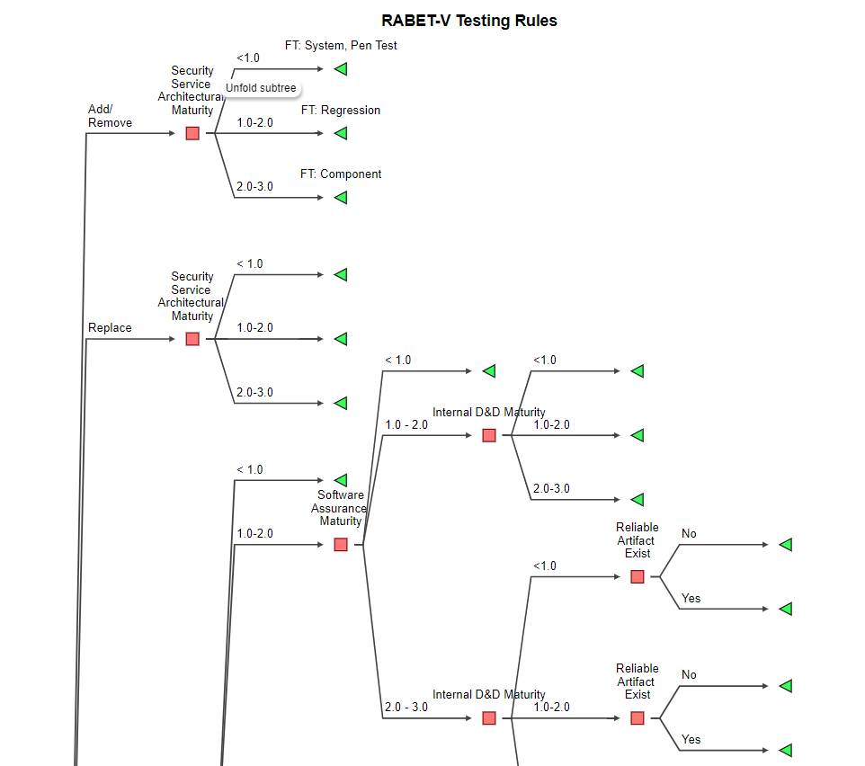
Testing Rules Determination
Test Conditions
Change Location
Security Service Relationship
Change Type
Security Service Architectural Maturity
Software Assurance Maturity
Specific Software Development Maturity
Reliable Artifact Exist
https://github.com/it-dept-cis/RABET-V-Pilot/blob/master/WorkingModel/Activities/Testing_Rules_Determination.md

Slide 24
Product Verification
Produces Security Services Capability Maturity (SSCM) scores
Test Plan Generation
Verification Methods
Artifact Review
Automated Testing
Functional Testing
Penetration Testing
Initial Submission will perform full testing
Subsequent revisions testing will vary
Test Security Requirements
Sanity Test Product Requirements
Out of scope testing: acceptance, beta, usability, etc.
https://github.com/it-dept-cis/RABET-V-Pilot/blob/master/WorkingModel/Activities/Product_Verification_Process.md

Slide 25
Reporting
Review of Product Verification Results and Determination
Verified
Conditional Verified
Returned
Product Provider Report Generation
Maturity Indexes Scores
Summary of Changes
Maturity Trends
Requirements Scores (Appendix)
Product Public Reporting Generation
https://github.com/it-dept-cis/RABET-V-Pilot/blob/master/WorkingModel/Activities/Reporting_Process.md

Slide 26
Review and Comment, How?
Review – pick the option that works best for you
This PPT
Word Document (forthcoming)
Github repo
Feedback Submission
Comments via Email (Aaron.Wilson@cisecurity.org, Katy@turnout.rocks)
Github Issues, pull requests

Slide 27
Questions
https://github.com/it-dept-cis/RABET-V-Pilot
Updated: 4/15/2020

Slide 28
Summarized Activities

Slide 29
Provider Submission & Submission Review
*Not expecting full submissions in pilot
Provider Submission
Initial Submission – goals, usage, security claims, diagrams*
Revision Submissions – change list, artifacts
Submission Review
Review submission for completeness
Determine which activities are necessary
https://github.com/it-dept-cis/RABET-V-Pilot/blob/master/WorkingModel/Activities/Provider_Submission.md
https://github.com/it-dept-cis/RABET-V-Pilot/blob/master/WorkingModel/Activities/Submission_Review_Process.md

Slide 30
Process Assessment & Architecture Review
Process Assessment
Determines the Software Development Maturity Scores – governance, design, implementation, verification, operations, and usability
Determines whether key development artifacts are reliable - I.e. Change List, automated testing results, 3rd party testing results.
Architecture Review
Produces Security Service Architecture (i.e. component mapping) & Security Service Architectural Maturity Scores
Performs threat analysis to understand architecture and threats
Identifies main system and software level components
Simplifies which one's impact security
Assesses the maturity of the product’s approach
https://github.com/it-dept-cis/RABET-V-Pilot/blob/master/WorkingModel/Activities/Process_Assessment_Methodology.md
https://github.com/it-dept-cis/RABET-V-Pilot/blob/master/WorkingModel/Activities/Architecture_Review_Methodology.md

Slide 31
Security Claims Validation & Testing Rules
Security Claims Validation
Claims are against security requirements (Met, Partially Met, Not Met, N/A)
Validate the claims and determine sufficiency for product specific risks
Testing Rules Determination
Builds “formula” for how to test the product
Uses a decision tree to capture the formula
Input: Individual changes
Output: Testing Approach
https://github.com/it-dept-cis/RABET-V-Pilot/blob/master/WorkingModel/Activities/Security_Claims_Validation.md
https://github.com/it-dept-cis/RABET-V-Pilot/blob/master/WorkingModel/Activities/Testing_Rules_Determination.md

Slide 32
Product Verification
Produces Security Services Capability Maturity (SSCM) scores
Test Plan Generation
Verification Methods
Artifact Review
Automated Testing
Functional Testing
Penetration Testing
Initial Submission will perform full testing
Subsequent revisions testing will vary
Test Security Requirements
Sanity Test Product Requirements
Out of scope testing: acceptance, beta, usability, etc.
https://github.com/it-dept-cis/RABET-V-Pilot/blob/master/WorkingModel/Activities/Product_Verification_Process.md

Slide 33
Reporting
Review of Product Verification Results and Determination
Verified
Conditional Verified
Returned
Product Provider Report Generation
Maturity Indexes Scores
Summary of Changes
Maturity Trends
Requirements Scores (Appendix)
Product Public Reporting Generation
https://github.com/it-dept-cis/RABET-V-Pilot/blob/master/WorkingModel/Activities/Reporting_Process.md

